Slide 1
Rank and Nullity And Solved problems of vector space
By Dr. Niharika Kulshrestha
CDA-102

Slide 2
Rank and Nullity are two essential concepts related to matrices in Linear Algebra.
The nullity of a matrix is determined by the difference between the order and rank of the matrix.
The rank of a matrix is the number of linearly independent row or column vectors of a matrix.
If n is the order of the square matrix A, then the nullity of A is given by n – r.
Thus, the rank of a matrix is the number of linearly independent or non-zero vectors of a matrix, whereas nullity is the number of zero vectors of a matrix.
The rank of matrix A is denoted as ρ(A), and the nullity is denoted as N(A).
Evidently, if the rank of the matrix is equal to the order of the matrix, then the nullity of the matrix is zero.

Slide 3
Rank and Nullity Theorem for Matrix
Null space
Let A be a real matrix of order m × n, the set of the solutions associated with the system of homogeneous equation AX = 0 is said to be the null space of A.
Null space of A = { x ∈ R^{n} | Ax = 0}. Then the nullity of A will be the dimension of the Nullspace of A.
If the rank of A is r, there are r leading variables in row-reduced echelon form of A and n – r free variables, which are solutions of the homogeneous system of equation AX = 0. Thus, n – r is the dimension of the null space of A. This fact motivates the rank and nullity theorem for matrices.

Slide 4
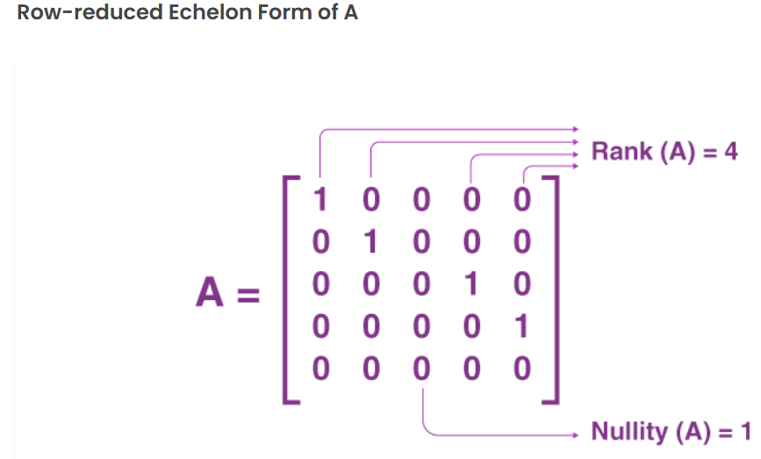









Slide 5

Rank and nullity theorem
If A is a matrix of order m × n, then
Rank of A + Nullity of A = Number of columns in A = n

Slide 6

Important Facts on Rank and Nullity
The rank of an invertible matrix is equal to the order of the matrix, and its nullity is equal to zero.
Rank is the number of leading column or non-zero row vectors of row-reduced echelon form of the given matrix, and the number of zero columns is the nullity.
The nullity of a matrix is the dimension of the null space of A, also called the kernel of A.
If A is an invertible matrix, then null space (A) = {0}.
The rank of a matrix is the number of non-zero eigenvalues of the matrix, and the number of zero eigenvalues determines the nullity of the matrix.

Slide 7























Slide 8





















Slide 9




Slide 10




























Slide 11





























Slide 12
























Slide 13
























Slide 14


















Slide 15


































Slide 16























Slide 17




























Slide 18




















Slide 19




























Slide 20




























